Slide 1
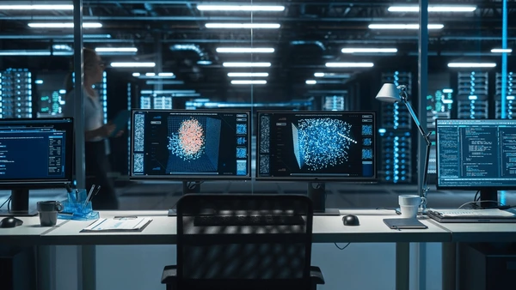
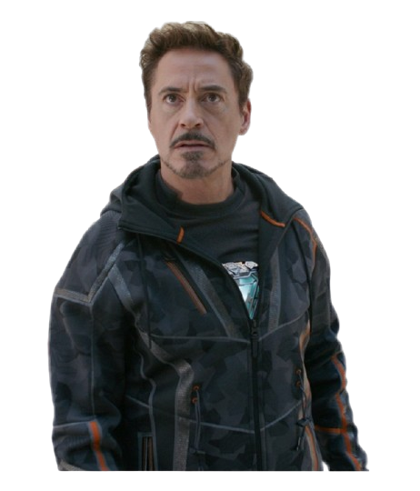
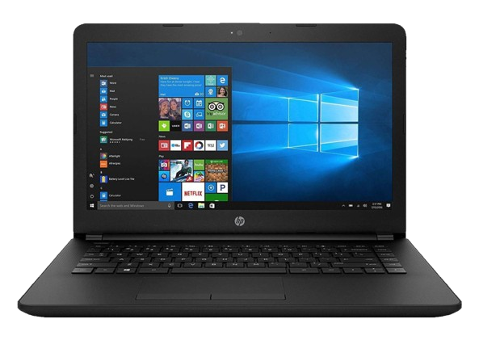

Slide 2
I wish that my old windows laptop was automated , or had any special AI features, so that my work would become easier.

Slide 3
Let me think about some Idea through which any old/new laptop can have AI features and tasks can be automated through voice prompts

Slide 4
IDEA!!!!!!!

Slide 5
Why not I create a Jarvis for Windows….

Slide 6

Introducing…

Slide 7
Jarvis – The AI Assistant

Slide 8
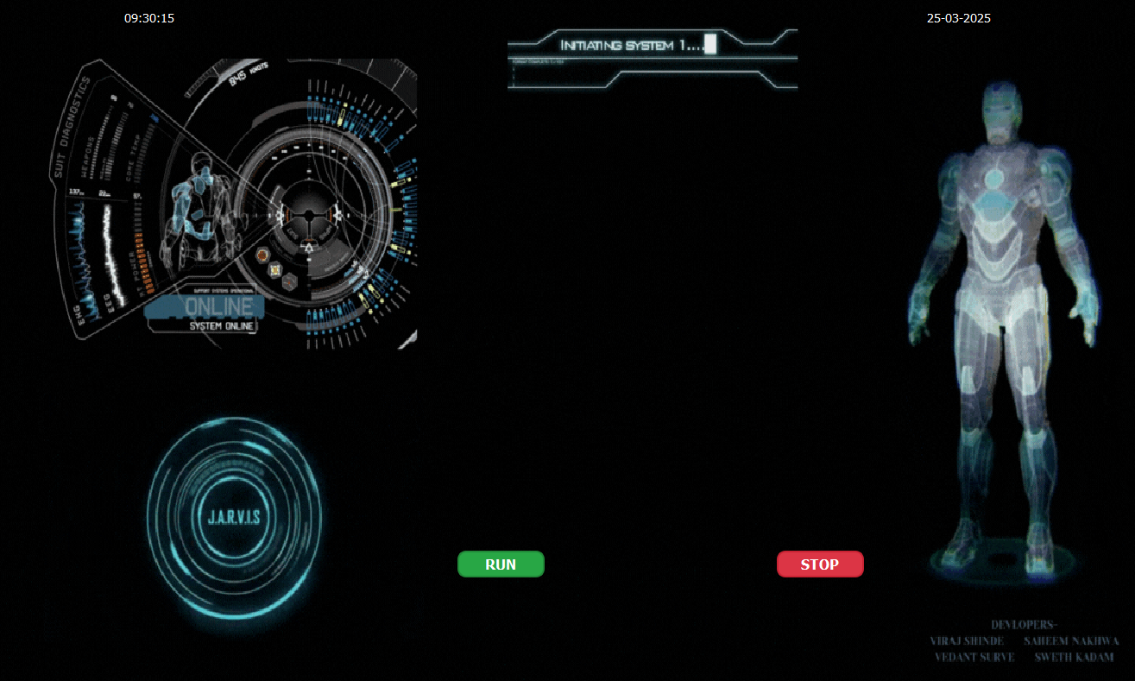
I can Send Messages through WhatsApp
I can open Applications
I can access the Wikipedia
I have my own independent GUI
I can play your favorite music
You can play chess with me
I can remember things you say
I can Create a PowerPoint
I am as smart as Gemini Ai
I’ll remind you about your daily tasks

Slide 9


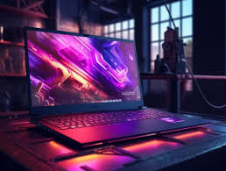
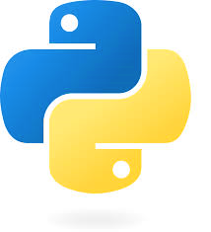

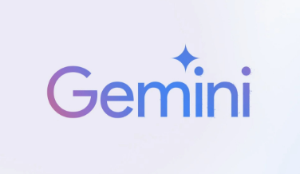
Resources
Laptop
Python
VsCode
Gemini AI’s API

Slide 10
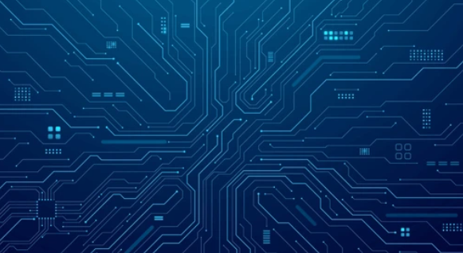
Laptop :
We used Laptop and Desktop to create our project since our project only supports desktop

Slide 11
We used an python based environment to develop our program.

Slide 12
We used VS Code IDE to develop our program as it supports Python and has a Smooth UI making the development easier

Slide 13
Google Gemini :
In order to make the Jarvis smart and dynamic we used Google Gemini To generate dynamic responses

